Slide 1


Interim
WSC
Report
workshop
Notes:
This workshop covers the content of the Interim WSC Report and some highlights of recent World Services’ work.

Slide 2

God, grant us
the serenity to
ACCEPT
the things we
cannot change, the
COURAGE
to change the
things we can, and the
WISDOM
to know the difference.
Notes:
God, grant us the serenity to ACCEPT the things we cannot change, the COURAGE to change the things we can, and the WISDOM to know the difference.

Slide 3

Interim WSC meeting
Interim WSC Report contains 12 motions
  Some are carry overs from WSC 2023
  Two are legally necessary
  Some offer new processes to make time for discussion/planning/collaboration
To keep things simple, only delegates will vote on these motions at the interim WSC
Notes:
The Interim WSC Report contains twelve motions.
A number are carry-overs from WSC 2023 that were scheduled to be dealt with on the closing day.
A couple are legally necessary—the one-year NAWS budget and the renewal of the travel policy.
Some of the motions are intended to make the WSC 2026 meeting smoother and hopefully clear up time and space at the 2026 WSC for more discussion.
The board chose to wait for the full WSC meeting to address things like The Loner revision because the 2026 CAR has wider Fellowship distribution.
Technically all 12 motions in the Interim Report could be considered CAT motions (the board votes on CAT motions), but in an effort to keep processes simple for this first interim WSC meeting, the board has decided to treat all 12 motions like CAR motions with delegates only voting and polling.

Slide 4

A Guide to World Services (GWSNA)
  The Interim Virtual WSC Report
  Decisions that are legally necessary and those that conference participants choose to address will be
  posted on na.org 90 days in advance of the Interim
  WSC meeting. All voting conference participants will
  be polled to choose the items they wish to address.
Notes:
GWSNA says very little about the Interim meeting. Beyond dates and deadlines, it simply says this:
The Interim Virtual WSC Report
Decisions that are legally necessary and those that conference participants choose to address will be posted on na.org 90 days in advance of the Interim WSC meeting. All voting conference participants will be polled to choose the items they wish to address.
This is the first deliberate three-year cycle and interim WSC meeting. Conference participants need to build a common understanding of the three-year cycle. The board has had many conversations about what a three-year cycle and interim WSC might look like and has tried to keep CPs informed every step of the way so that we can build this new system together.
Once the conference has more experience with an interim meeting and more of a consensus about what seems to work, we can clarify the description in GWSNA.
One idea is to use the time to help shape the strategic plan and the CAR survey. Hopefully motions can be decided on relatively quickly and the rest of the interim WSC can be spent on the strategic plan.

Slide 5

Deadline for amendments
Deadline for amendments to be
in final form 15 days before
the interim meeting
That is 13 February
Don’t wait
Notes:
The deadline for amendments to be in final form is February 13th, which is 15 days before the interim meeting.
As soon as possible after the amendment deadline, delegates will get an initial straw poll to respond to the motions themselves—it’s the first part of the actual decision-making process.
WSC Cofacilitators will review the decision-making processes in detail at the orientation meeting on February 15th—open to CPs only.

Slide 6

Interim WSC Report
na.org/conference
Let’s review the
12 motions
Notes:
Now we’re going to review the twelve motions in the Interim Report.
The Interim report is posted at na.org/conference in English, Portuguese, and Spanish, and this PowerPoint is posted there as well.
If you have any questions you can always email wb@na.org.

Slide 7
Motion 1: To adopt for the 2025 Interim WSC and the
2026 WSC only: If a motion has consensus in an initial straw poll (that’s 80% or more in support or not in support), the Cofacilitators will announce the results as a final decision.
Intent: To minimize time spent addressing items the conference already has agreement on.
Notes:
Motion One
To adopt for the 2025 Interim WSC and the 2026 WSC only: If a motion has consensus in an initial straw poll (that’s 80% or more in support or not in support), the Cofacilitators will announce the results as a final decision.
Intent: To minimize time spent addressing items the conference already has agreement on.
If this motion passes, it would mean that when the body has consensus in the initial straw poll of a motion, that would be declared a decision. When the body is in session, the cofacilitators would simply announce the decision with the poll results.

Slide 8
Motion 1
Rationale: This change is offered as a one-cycle experiment to free up scarce WSC session time so that the body can take the next steps in the new strategic planning process. It is difficult to look at one change in an overall system, but the WSC seems to evolve most effectively one step at a time. When the new planning process is fully implemented, the goal is true collaboration among conference participants, creating and refining motions together before the motions are posted for worldwide Fellowship consideration. That collaboration would allow all voices, including the minority, to be heard. Considering all perspectives in the process of co-creating the CAR and items for decision gives the minority voice more influence in shaping ideas and, ultimately, decisions.
Notes:
Motion 1 asks to try this for the interim meeting and WSC 2026 only. If the body likes that experiment, it can then pass a motion to adopt this as ongoing policy. The conference has had good luck in the past trying new processes before adopting them as policy, and this motion continues in that vein.
The goal of the new planning process is a more collaborative approach that considers all perspectives in the process of creating the CAR and the items for decision. As the rationale states “When the new planning process is fully implemented, the goal is true collaboration among conference participants, creating and refining motions together before the motions are posted for worldwide Fellowship consideration. That collaboration would allow all voices, including the minority, to be heard. Considering all perspectives in the process of co-creating the CAR and items for decision gives the minority voice more influence in shaping ideas and, ultimately, decisions.”

Slide 9
Motion 1, rationale continued
The board is committed to the Ninth Concept, and even now, before the new planning process is in place, there is ample discussion before decisions are taken at the WSC. Conference participant web meetings, CAR workshops, the conference participant discussion board, and other forums ensure that items are thoroughly discussed and all viewpoints are considered before an initial straw poll is taken. Hearing voices at the WSC itself after a motion has achieved consensus has not affected any change in the outcome. The purpose of this motion is not to silence any voices, it’s to make our voices more meaningful and allow more time for productive, creative discussion.
Notes:
When this idea was discussed at the September CP web meeting, some participants expressed concern, which is understandable. The board is fiercely committed to making sure the minority voice is heard. But the reality is the body spends hours discussing items it already has consensus on, only to pass the motions in the end.

Slide 10
Motion 1, rationale continued
At WSC 2023, more than 6 ½ hours of conference time (more than a full day of WSC session time) were consumed deciding on motions that had consensus in an initial straw poll. All 28 of those motions ultimately passed 27 of them with consensus and one with 79% support. Our time together as a body is so limited; we believe it is more effective and productive to use WSC time and this unique global perspective to collaborate on building the items for decision together.
Pause for discussion
Notes:
At WSC 2023, more than 6 ½ hours of conference time (more than a full day of WSC session time) were spent deciding on motions that had consensus in an initial straw poll. All 28 of those motions ultimately passed.
The purpose of this motion is to use that time to hear the minority voice when it has more of a chance to influence an outcome.

Slide 11
Motion 2: To approve the 2023 World Service
Conference minutes.
The draft of the minutes can be found at
na.org/conference
Pause for discussion
Notes:
Motion 2 is simply to approve the 2023 WSC minutes. The draft is posted on the conference page, which is na.org/conference.

Slide 12
Motion 3: To approve the 2025–2026 Narcotics Anonymous World Services, Inc. Budget. (See Addendum A)
Intent: To have an approved NAWS Budget through WSC 2026.
Notes:
Motion 3 is to approve the one-year budget that will take us through the end of the cycle. We will offer a three-year budget in the 2026 Conference Approval Track material.

Slide 13
Motion 3
Rationale: At WSC 2023, NA World Services only offered a two-year budget to the WSC because the conference had not yet decided to try a three-year cycle. Until a decision about a three-year conference cycle had been made, it seemed presumptuous to do otherwise. This budget will cover NA World Services until the close of this conference cycle after WSC 2026. The basic budget categories and definitions remain the same as the 2023–2025 budget. The fifteen-page cover memo for that budget in the 2023 Conference Approval Track material offers much detailed information about the structure, categories, and details of the World Services’ budget. You can find it at na.org/conference in the WSC Archive section. AT WSC 2026, we will offer a budget for 2026–2029.
As a reminder, this budget covers all activities for NA World Service locations in Belgium, Canada, India, Iran, and the US.
Notes:
NA World Services only offered a two-year budget at WSC 2023 because the conference had not yet decided to try a three-year cycle. This budget will cover NA World Services until the close of this conference cycle after WSC 2026.
The World Services budget is complex. There is a detailed explanation of terms and categories in the budget cover essay in each Conference Approval Track material. If this is your first time looking at the NAWS budget, you may want to read the essay in the 2023 CAT, which is posted in the archive section of the conference page (na.org/conference).
The thing that has probably raised the most questions is the figures for WCNA. As the budget description says, “All of the figures previously approved at WSC 2023 are shown in this draft, including those for WCNA 38. The WCNA figures were presented two and a half years before the event and do not represent the working budget for the event or actual income and expense.”

Slide 14
Motion 3
Differences in the 2025–2026 Budget:
• The base year is used as the foundation, with these adjustments—
    A 2.5% increase for contributions
    A 7.5% increase for literature income
    An 11% increase for literature expense, and
    A 5% increase for other expenses.
• Added a line item for the NA Survival Kit and reduced projected income for most books (Except Basic Text and It Works)
• Expenses for WSC, HRP, and WSC cofacs moved from the 2025 FY to the 2026 FY because a 3-year cycle was approved
• Moved line-item expenses from the Literature Production and Distribution category to line items under Cost of Goods Sold
Pause for discussion
Notes:
The board tried to make as few changes as possible to the approach in this budget. The differences are outlined in the budget description following Motion #3 in the Interim Report.
The proposed budget is based on the average of fiscal years 2023 and 2024. The changes we made include
A 2.5% increase for contributions
A 7.5% increase for literature income
An 11% increase for literature expense, and
A 5% increase for other expenses
A line item for the NA Survival Kit has been added and projected income has been reduced for most books (except BT and IWHW).
Expenses related to the conference (WSC, HRP, and Cofacs) were moved to reflect the new 3-year cycle. Also line-item expenses from the literature projection and distribution category were moved to Cost of Goods Sold.

Slide 15
Motion 4: To extend the 2023–2025 Reimbursement Policy through the 2026 fiscal year.
Intent: To keep the 2023 WSC approved policy in place through the next WSC.
Notes:
Motion #4 is simple—to extend the reimbursement policy through the 2026 fiscal year.

Slide 16
Motion 4
Rationale: At WSC 2023, the conference approved a Reimbursement Policy that includes the daily per diem amount.
(See Addendum A of A Guide to World Services in NA https://na.org/wp-content/uploads/2024/06/GWSNA-English-2023-26.pdf). This motion would keep that policy in place through WSC 2026.
Pause for discussion
Notes:
Because the board didn’t know in 2023 if the conference would approve a three-year cycle, they offered a two-year reimbursement policy. This motion would cover world services until the conference can pass a new reimbursement policy for the cycle ahead.

Slide 17
Motion 5: To adopt for the current conference cycle only: The 2026 WSC will take a new step in Strategic Planning by using a revised process (described below) for the CAR survey to consider ideas for recovery literature, service material, and Issue Discussion Topics. Instead of submitting motions for project plans to create specific pieces of service material, recovery literature or IDTs for the 2026 Conference Agenda Report, conference participants will submit those ideas for possible inclusion in the 2026 CAR survey.
Notes:
Motion 5 reads:
To adopt for the current conference cycle only: The 2026 WSC will take a new step in Strategic Planning by using a revised process (described below) for the CAR Survey to consider ideas for recovery literature, service material, and Issue Discussion Topics. Instead of submitting motions for project plans to create specific pieces of service material, recovery literature or IDTs for the 2026 Conference Agenda Report, conference participants will submit those ideas for possible inclusion in the 2026 CAR survey.

Slide 18
Motion 5
Intent: To implement a process for all conference participants to collaboratively create a CAR survey with all ideas for Fellowship consideration of literature, service materials, and Issue Discussion Topics.
Rationale: We are proposing a process for conference participants to work together to create the CAR survey, which would contain all of the ideas for literature, service material, and Issue Discussion topics to be considered by the WSC. The CAR survey process allows any member or service body to forward ideas for consideration for new or revised recovery literature, service material, or Issue Discussion Topics.
Notes:
The intent is
To implement a process for all conference participants to collaboratively create a CAR survey with all ideas for Fellowship consideration of literature, service materials, and Issue Discussion Topics.
Put simply, this motion asks us to create the CAR survey collaboratively, and to use the CAR survey for all ideas for new and revised pieces of literature and service material as well as Issue Discussion Topics.
The rationale reads:
Rationale: We are proposing a process for conference participants to work together to create the CAR survey, which would contain all of the ideas for literature, service material, and Issue Discussion topics to be considered by the WSC. The CAR survey process allows any member or service body to forward ideas for consideration for new or revised recovery literature, service material, or Issue Discussion Topics.

Slide 19
Motion 5, rationale continued
That can result in lengthy lists of ideas. The proposed revisions to the process keep the doors open for all members to submit ideas, and give conference participants a mechanism to create a more manageably sized final draft of the survey.
The CAR survey results have helped conference participants determine priorities for NA World Service literature and service material projects and IDT’s since WSC 2016. The CAR survey allows all ideas about the focus of these projects to be looked at and prioritized side by side. Currently, when the conference passes a regional or zonal motion to create a project plan for a specific piece of literature or service material, that idea gets included in the CAR survey for potential prioritization by the conference.
Notes:
That can result in lengthy lists of ideas. The proposed revisions to the process keep the doors open for all members to submit ideas, and give conference participants a mechanism to create a more manageably sized final draft of the survey.
The CAR survey results have helped conference participants determine priorities for NA World Service literature and service material projects and IDT’s since WSC 2016. The CAR survey allows all ideas about the focus of these projects to be looked at and prioritized side by side. Currently, when the conference passes a regional or zonal motion to create a project plan for a specific piece of literature or service material, that idea gets included in the CAR survey for potential prioritization by the conference.

Slide 20
Motion 5, rationale continued
If Motion #5 were to pass, those ideas would go directly into the CAR survey rather than being included in the CAR as separate motions. This allows ideas to be acted on more quickly if prioritized by the conference by being in the CAR survey immediately rather than the following cycle. (For more information, see the Current Project Process & Status document posted on na.org.) This proposed revision to the process would still allow all members and service bodies to offer ideas, but it builds in more collaboration to create the survey itself. The new process would empower conference participants to collectively create the survey by adding prioritization and approval steps by conference participants before the survey is finalized for inclusion in the Conference Agenda Report.
Notes:
If Motion #5 were to pass, those ideas would go directly into the CAR survey rather than being included in the CAR as separate motions. This allows ideas to be acted on more quickly if prioritized by the conference by being in the CAR survey immediately rather than the following cycle. (For more information, see the Current Project Process & Status document posted on na.org.) This proposed revision to the process would still allow all members and service bodies to offer ideas, but it builds in more collaboration to create the survey itself. The new process would empower conference participants to collectively create the survey by adding prioritization and approval steps by conference participants before the survey is finalized for inclusion in the Conference Agenda Report.

Slide 21
Motion 5, rationale continued
Thousands of members voice their preferences for literature, service material, and Issue Discussion Topics through the CAR survey (7,731 in 2023). The CAR survey is a profoundly inclusive tool: any member of the Fellowship, any group, any service body is able to weigh in on what matters most to them and what should be a priority for the work.
Notes:
Thousands of members voice their preferences for literature, service material, and Issue Discussion Topics through the CAR survey (7,731 in 2023). The CAR survey is a profoundly inclusive tool: any member of the Fellowship, any group, any service body is able to weigh in on what matters most to them and what should be a priority for the work.

Slide 22
Motion 5, rationale continued
Proposed CAR survey Process:
• Start fresh! Reintroduce any ideas from the 2023 CAR survey
• Ideas emerging from discussions at the Interim WSC could be added
• Any member or service body could submit ideas before deadline
• When lists of ideas are compiled, conference participants
would prioritize them via ballot
• Results of prioritization would be distributed
and together we would condense list
• In this way, the conference would collectively
create the final lists for the CAR survey.
Notes:
How it would work is that we would start with a clean slate each cycle and then conference participants would collectively create a new survey.
Anyone can submit an idea and then conference participants will prioritize them and condense the list together.

Slide 23
Motion 5, rationale continued
Timeline:
March 2025: Email conference participants link to 2023 CAR survey and ideas received since 2023.
March–May 2025: Collect ideas for 2026 CAR survey, including ideas generated at Interim WSC.
June or July 2025: Ballot of all ideas sent to Conference Participants. (prioritize or simple yes/no?)
August 2025 CP web meeting: Discuss list and prepare list of ideas for the 2026 CAR survey. The list could be finalized at
the web meeting or require another ballot.
Pause for discussion
Notes:
After the interim WSC meeting, the board would mail conference participants the ideas received since WSC 2023 about what to add to the CAR survey and a link to the 2023 CAR survey as a reference.
All of the ideas for what should go on the CAR survey would be collected. The ideas can be items people want to carry forward from the 2023 survey or they can be new ideas.
All of the ideas would be compiled into one list and then a ballot would be created so that in June or July conference participants can prioritize which items they think should go in the CAR survey.
Then, at the August conference participant web meeting, participants would discuss the ballot results and come to a collective agreement about what goes in the survey. There may be items that get combined at this point or there may be a need for one more round of balloting.
The hope is that this new process results in a shorter, more logical list of items for the CAR survey, and more importantly, that the survey reflects the collective thoughts of the conference as a whole.
The motion is asking to try this new process as an experiment for one cycle.

Slide 24
Motion 6: To update A Guide to World Services in NA (GWSNA ) amendment deadline policy to include first draft due
forty-five (45) days in advance of WSC and final amendment deadline thirty (30) days in advance of WSC.
Policy Affected: Changes to GWSNA (pages 13 & 14):
Amendments to motions must be submitted no less than fifteen forty-five days before the opening day of the WSC with final form expected no less than thirty days in advance of the WSC opening day.
Notes:
The board is offering a number of motions on behalf of others. The Human Resource Panel (HRP for short) and the WSC Cofacilitators cannot make motions, but they are well positioned to offer ideas for improvements to the nominations and decision-making processes of the conference.
Motions 6 through 9 were framed by the cofacilitators.
Motion 6 would change the deadline for amendments from the current deadline of 15 days prior to the WSC to 30 days in advance. A first draft of amendments would be due 45 days in advance of the WSC.

Slide 25
Motion 6
Intent: To establish deadlines for the submission of amendments that allow for time to get a draft amendment conference ready and to be translated and straw polled in advance of the WSC meeting.
Rationale: Establishing an amendment deadline ahead of the WSC aids in the ability for Conference Participants to review all the information that will be discussed on each motion ahead of time. Establishing appropriate deadlines lends to the ability to communicate the possible items for discussion on motions ahead of the WSC to conference participants.
Notes:
There are 15 days between the first draft deadline and when the final version is due so that participants have time to work with the cofacilitators to make sure an amendment is conference-ready. It also gives time for participants who are offering similar amendments to work together on their ideas.

Slide 26
Motion 6, rationale continued
This also helps with conducting the initial straw poll ahead of the WSC by having the amendments on the initial straw poll it can help frame the decision-making sessions. Another reason for this consideration is for the purpose of translations allowing them the necessary time to translate the information ahead of the WSC and the straw polls. The initial straw poll is currently sent to conference participants in English, Spanish, and Portuguese.
Pause for discussion
Notes:
These deadlines allow time for the amendments to be translated, to be considered by the Fellowship and conference participants, and to do an initial straw poll.

Slide 27
Motion 7: To add to GWSNA amendment deadline policy to include first draft due thirty (30) days in advance of interim WSC and final amendment deadline fifteen (15) days in advance of interim WSC.
Policy Affected: Add to GWSNA (pages 13 & 14):
For the interim WSC amendments must be submitted no less than thirty days with final form expected no less than fifteen days in advance of the opening session.
Notes:
Motion 7 is also about amendment deadlines, this time for the interim WSC meeting. Because of the tighter timeline, the proposed deadlines for amendments for the interim meeting are 30 days in advance for the rough draft and 15 days in advance for the final version.

Slide 28
Motion 7
Intent: To establish deadlines for the submission of amendments that allow for time to get a draft amendment conference ready and to be translated and straw polled in advance of the interim WSC meeting.
Rationale: Establishing an amendment deadline ahead of the interim WSC aids in the ability for Conference Participants to review all the information that will be discussed on each motion ahead of time. Establishing appropriate deadlines lends to the ability to communicate the possible items for discussion on motions ahead of the interim WSC to conference participants
Notes:
Again, it can take time for participants to communicate with the conference cofacilitators to get an amendment conference-ready.
And amendments for the interim WSC meeting motions also need to be translated, considered by the Fellowship and conference participants, and included in an initial straw poll.

Slide 29
Motion 7, rationale continued
This also helps with conducting the initial straw poll ahead of the interim WSC by having the amendments on the initial straw poll it can help frame the decision-making sessions. Another reason for this consideration is for the purpose of translations allowing them the necessary time to translate the information ahead of the interim WSC. The timeline from the Interim WSC Report to the interim WSC is condensed in comparison to the in-person WSC, with the interim WSC report coming out 90 days before the meeting. For that reason the window for amendment submissions is a tighter timeline.
Pause for discussion
Notes:
The Interim WSC Report has a tighter timeline, and so the window for amendment submissions is also shorter. The Interim WSC Report is posted 90 days in advance of the WSC

Slide 30
Motion 8: To add the following language defining amendments to the CAR & CAT-related paragraphs in
GWSNA (pages 13 & 14) :
An amendment to a motion is a change or addition designed to improve the motion. The purpose of an amendment is to refine a motion to move the Fellowship closer toward consensus. An amendment should clarify, add, or subtract language that keeps the motion consistent with its intent. An amendment shall not replace a motion or introduce a substitute or contrary motion. A motion to split or divide a motion is an amendment to the motion.
Notes:
Motion 8 offers a definition of amendments to be included in A Guide to World Services. The motion reads:
To add the following language defining amendments to the CAR & CAT-related paragraphs in GWSNA: (Pg. 13 & 14)
An amendment to a motion is a change or addition designed to improve the motion. The purpose of an amendment is to refine a motion to move the Fellowship closer toward consensus. An amendment should clarify, add, or subtract language that keeps the motion consistent with its intent. An amendment shall not replace a motion or introduce a substitute or contrary motion. A motion to split or divide a motion is an amendment to the motion.

Slide 31
Motion 8
Intent: To clearly define the purpose of an amendment and its relation to a motion.
Rationale: The current language regarding amendments in GWSNA needs refining to fit the current process being used by the WSC. With a discussion-based conference, we see that amendments are useful to enhance or clarify a motion that is being discussed. However, there are times when an amendment may attempt to also change the outcome or intent of a motion and that is not an improvement to a
motion, but more of a con for voting in favor.
Pause for discussion
Notes:
GWSNA has very little explanation of what an amendment is, and this motion aims to expand the explanation. Amendments can help clarify or enhance motions, but the spirit of an amendment shouldn’t be to change the outcome or intent of a motion. If someone is against a motion, they should simply vote con.

Slide 32
Motion 9: To make the following changes regarding amendments and replacements of motions during the decision-making process to Addendum D (page 67) in GWSNA :
8. The Conference may decide to replace or amend motions that have been presented based on prior discussions. When the motion is presented, the WSC Co-facilitator may recognize any participant offering a replacement or amendment, or offer a suggestion to the Conference during the discussion of a motion. If supported by two-thirds of the Conference, the replacement/amendment will be accepted. The WSC Co-facilitator may interrupt this simplified process at any time they believe such action is warranted.
Notes:
Motion 9 would also revise language in A Guide to World Services in NA. The proposed changes are on the screen. If the motion passes, the revised language would read:
The Conference may decide to replace or amend motions that have been presented based on prior discussions. When the motion is presented, the WSC Cofacilitator may recognize any participant offering a replacement or amendment, or offer a suggestion to the Conference during the discussion of a motion. If supported by two-thirds of the Conference, the replacement/amendment will be accepted. The WSC Co-facilitator may interrupt this simplified process at any time they believe such action is warranted.
Motion 9 is about amendments or replacement motions being introduced during floor discussions at the WSC. Conference participants can still propose amendments before the deadline prior to the WSC.

Slide 33
Motion 9
Intent: To revise GWSNA to reflect the current practices of the WSC on how amendments or replacements to motions based on discussion are handled during business sessions.
Rationale: In consensus-based decision making, there may be times when the discussion reveals a solution that is amenable to the decision-making process. It is our belief that during a discussion-based conference there are times when the discussion leads to a change that should be considered by the body based on the direction the discussion has gone regarding a motion. Current practice of the WSC has been to not allow amendments or replacement motions from Conference Participants on the floor of the conference.
Notes:
As the intent explains, these changes to the text in A Guide to World Services would actually mirror practices that are already in place.
At times when business gets bogged down at the WSC, discussion may reveal a way to refine a motion that would bring the body into consensus. Current practice is not to allow members of the body to make amendments or replacement motions during session.

Slide 34
Motion 9, rationale continued
Although, there have been instances where the cofacilitators have offered amendments or replacements based on the direction of discussion from the body to evolve the motion for its support. On the last day of the first part of WSC 2020, for example, the body spent a long time discussing what to do next. The body had been polled overnight “Do you want to come back together virtually as a WSC in this conference cycle to consider CAR and CAT motions?” and while there was strong support in an initial straw poll, the body was unable to reach a decision about next steps for the conference.
Notes:
Motion 9 would empower the cofacilitators to be the vehicle to offer an amendment or replacement motion, allowing them to gauge the body and guide the process more effectively towards consensus. This took place at WSC 2020.

Slide 35
Motion 9, rationale continued
Finally, after extensive discussion, the cofacilitator offered a proposal “Do you support to come back together virtually as a WSC 2020 in this cycle with the items for decision to be determined by CPs through eballot?” After some discussion, it passed with consensus. While these scenarios may not be common, the aspiration of a discussion based conference rooted in CBDM should have a mechanism for the discussion of the body to evolve a motion.
Pause for discussion
Notes:
As the rationale explains. While this type of intervention may not be common, a discussion-based conference rooted in CBDM should have a mechanism to evolve a motion based on the discussion of the body.

Slide 36
Motion 10: All candidates for World Service positions are forwarded to the HRP from regions, zonal forums, or the World Board (RBZ).
Intent: To revise WSC policy to reflect current practices.
Rationale: Since the start of the RBZ process in 2006, the overwhelming majority (over 95%) of elected World Board members have had at least one RBZ recommendation. Including HRP and Cofacs, 73% have had an RBZ recommendation. Since 2006, no direct nominations
from conference participants have resulted in WSC election.
Pause for discussion
Notes:
The next two motions the board is making on behalf of the Human Resource Panel, or HRP. Both of these motions reflect processes that were used at the last conference. These motions would put those current practices into policy.
Motion 10 would require each candidate for nomination to a World Services position to have a recommendation submitted to the HRP from a region, zone, or the World Board. That’s known as an RBZ for short—which stands for region, board, zone.
As the rationale for this motion explains, the vast majority of elected candidates have had an RBZ recommendation. By the time elections take place at WSC 2026, it will have been 20 years since a direct nomination from a conference participant resulted in an election.

Slide 37
Motion 11: If Motion 10 is adopted, to redefine the purpose of the World Pool to be used to retain information on candidates forwarded for consideration by regions, zones, and the World Board as a part of the Human Resource Panel’s nomination process.
Intent: To revise WSC policy to reflect current practices.
Notes:
Motion 11 is related. If Motion 10 passes, Motion 11 asks to repurpose the World Pool to retain information on candidates forwarded through the RBZ process.

Slide 38
Motion 11
Rationale: With the adoption of Motion 10, the World Pool would no longer be needed to collect information on members willing to be of service at the world level. The World Pool has proven ineffective for identifying trusted servants for projects and workgroups. The World Board uses an online form to allow members to express interest in participating in the current cycle’s projects. The existing member data would remain in the World Pool.
Pause for discussion
Notes:
As with Motion 10, Motion 11 would change written policy to match existing practices. The HRP did not use the World Pool to source candidates for nomination at the last WSC, and instead relied on RBZ recommendations.

Slide 39
Motion 12: To not utilize a seating workgroup for the 2023–2026 cycle.
Intent: To attempt a simpler process for compiling seating information and recommendations.
Rationale: It has been a time-tested practice of the WSC to try changes for one conference cycle before deciding whether or not to change policy. This motion joins that tradition. If this motion passes, the seating process described on pages 34 & 35 of A Guide to World Services in NA would be unchanged except that we would not be utilizing a workgroup to make recommendations to the board.
Notes:
Motion 12 To not utilize a seating workgroup for the 2023–2026 cycle.
This is another motion that asks the conference to try something as an experiment for one cycle.
The seating application process described in A Guide to World Services would not change except that a workgroup would not be making recommendations to the World Board.

Slide 40
Motion 12, rationale continued
Regions requesting seating would still submit the information described in GWSNA, and the conference would still receive all of that information along with recommendations from the board. In the past, a workgroup has reviewed all of the submissions and made recommendations to the board, but it seems that the information from the regions themselves has been the most important consideration for both the board and the conference. It’s the board’s job to make prudent decisions about NAWS’s resources, and we believe the labor and time required for seating workgroup meetings could be better applied to other work. If it seems to go well this cycle, a motion can be made in the
future to change policy on an ongoing basis.
Pause for discussion
Notes:
The same information would be gathered from regions requesting seating, and would be included in the Conference Approval Track, but a workgroup would not be created to review all of the information and make recommendations to the board.
The workgroup’s recommendations have not been consistently taken by the board. The information from the requesting regions themselves seems to be the most influential in the conference’s decisions.
In 2023, for instance, five regions requested seating. The workgroup recommended seating four of the regions. The board did not offer any motions to seat regions. The conference decided to seat all five regions.
Creating a workgroup just doesn’t seem like an effective use of resources.
That’s the last of the proposed motions. Following are updates about some of World Services Recent activity.

Slide 41
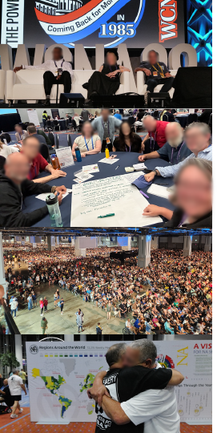
WCNA 38
Over 21,000 registered for 2018
Expected 24,000 for 2024
7,000 short of breaking even
Costs went up
Still working on final figures—
looks like expenses exceed
income by just over $800,000
Notes:
WCNA was a great success in many ways. There were some challenges, but most of the feedback has been very positive.
Registration numbers were low, however.
Over 21,000 registered for the World Convention in Orlando six years earlier in 2018, so it seemed realistic to expect around 24,000 in DC. After all, Washington is located within five hundred miles of North America's most densely populated NA communities. However, we were approximately 7,000 people short of what had been budgeted as a breakeven point for registration.
The budget adopted at WSC 2023 for WCNA 38 was created almost two years before the event and was largely based on the experience in Orlando. The World Board created a working budget to establish the registration price for the event. The actual expense for WCNA 38 came in very close to the numbers in that working budget but the income did not.
World Services is still working on final figures for the convention but it looks like, after merchandise and event income have been factored in, expenses for the World Convention will exceed income by just over $800,000. One of the reasons World Services has reserve accounts is to protect us in the case of unforeseen experiences like this one.

Slide 42
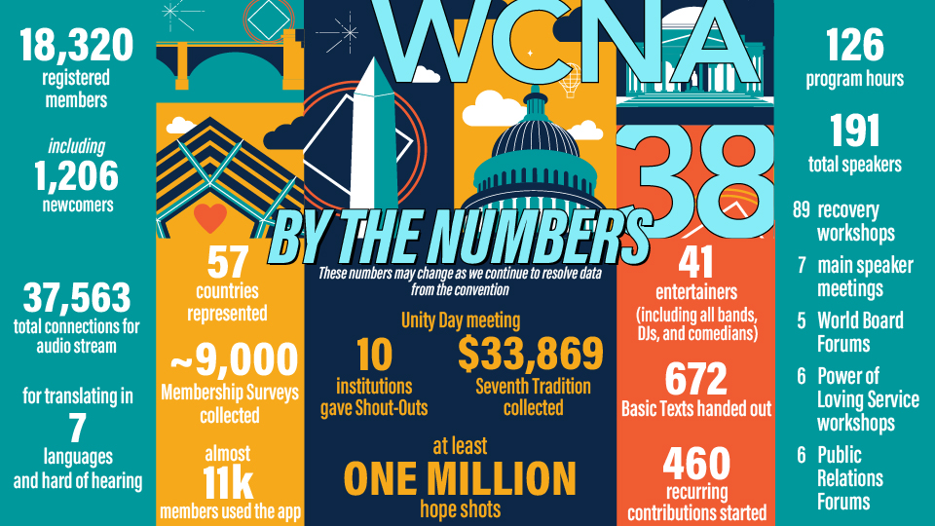
Notes:
The board created a survey to get a better idea of what led to such poor attendance in DC and what is important to members for the future. Please, fill out the survey at na.org/survey and encourage members in your region and zone to do so as well.
The World Board has a discussion scheduled for their in-person meeting in January. That discussion likely won’t to lead to a final decision in January, but it will help to provide direction. When the board has a recommendation about the future of the World Convention, they will talk to conference participants about it and seek their approval.

Slide 43

Notes:
The Membership Survey pamphlet is a valuable PR tool. This survey gives us “evidence” that NA works. It helps show professionals who we are as a Fellowship and the difference NA has made in the lives of addicts. This is especially important now, when there are so many different ideas about treating addiction out there.
The QR code on your screen will take you to the survey. Once you get there, a dropdown menu lets you select any of the many languages it’s posted in.
The survey will be posted until the end of January.

Slide 44

Working on translations.
Farsi and Spanish in production now.
Then Brazilian Portuguese and Russian to be next, and then Swedish.
$20
Item #9425
Notes:
Farsi and Spanish translations of the NA Survival Kit are in the production process now. Next World Services expects to be working on Brazilian Portuguese and Russian, and then Swedish. Other language communities have asked about versions, and NAWS is in communication to get those worked on as well.

Slide 45

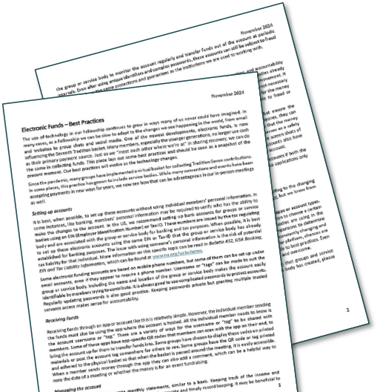
Service workshops!
na.org/idt
Electronic Funds
(Money Management)
na.org
/virtual
/localresources
Notes:
All of the Power of Loving Service workshops from WCNA have been adapted and posted for local use. The topics range from Social Media to Additional Needs to Fund Flow. You can find them in the Service Workshop section of the IDT webpage, which is na.org/idt.
Also just posted is a resource that collects best practices on Electronic Funds (Money Management). It was put together for the WCNA service workshop called Dear Prudence. The Electronic Funds resource is located in a number of places on NAWS website, including na.org/virtual and na.org/localresources. A number of people have asked World Services for something to help with handling electronic fund flow, and this fills that gap.

Slide 46

Issue Discussion Topics
na.org/idt
Open
Fellowship
web
meetings
Notes:
The board is thinking about holding a general web meeting open to all who want to workshop the Issue Discussion Topics, or IDTs. The four topics this cycle are displayed on your screen. Workshop materials are all posted on na.org/idt.
World Services may also work on some mid-cycle revisions for some of the IDTs. If you have ideas for revising any of the IDT workshop materials, please email wb@na.org.

Slide 47

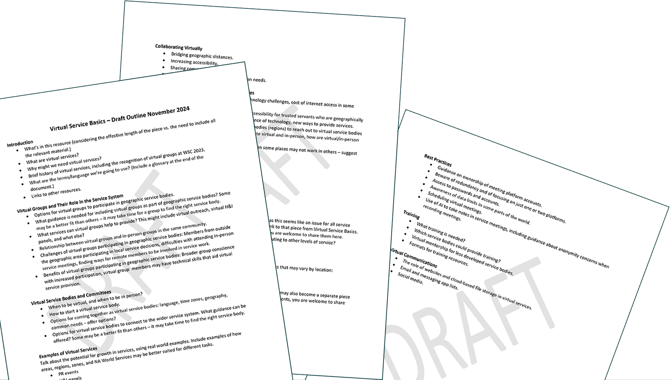
Virtual Service Basics
na.org/toolbox
Notes:
The board also just posted a draft outline for Virtual Service Basics and a survey where you can give input on the outline: na.org/toolbox.
If you have any experience with virtual service or with connecting virtual groups to the service system, please share it through the survey form. You don’t have to answer every question.

Slide 48


Posted for input soon
IP #21 revisions
H&I Basics revisions
Notes:
World Services is currently also working on the revisions of H&I Basics—first the corrections piece is being drafted, and next will be the treatment piece. You can expect to see those posted for input soon. And the revision to IP #21, will likely be posted for review before the interim WSC meeting.

Slide 49
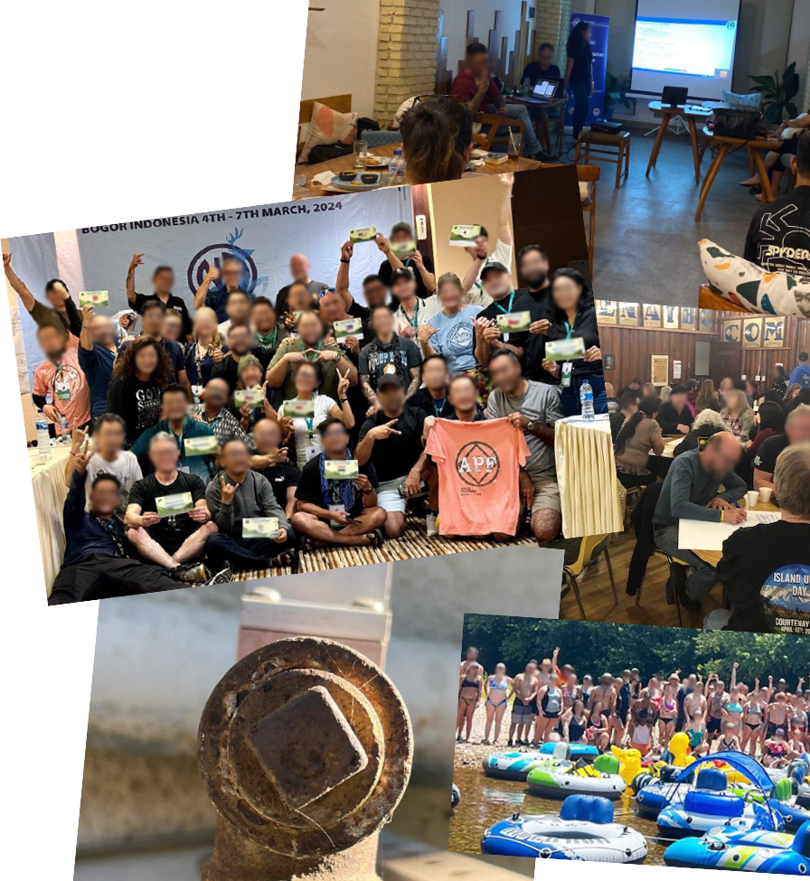
Keep sending us cool Fellowship photos
na.org/wcna
“Share Your Photos”
• events • workshops •
• meeting places • FD •
• found service symbols •
Notes:
Please keep sending World Services photos of local workshops or events. They use them in videos and PowerPoints and even social media. (For a photo to be used in social media it needs to not show any members’ faces.) There’s a photo upload form on the convention page, which is na.org/wcna. Thanks!

Slide 50
Thank you
Notes:
Thank you for coming today. Again, if you have any questions, send them to wb@na.org.

